Slide 1
PROBLEM BACKGROUND
“Gambler’s Ruin” Analysis

Slide 2
Index
Problem Background: Gambler’s Ruin
Simulation: Testing with 2 players
Simulation: Testing with 3 players
Simulation: Testing with 4 players
Simulation: Analysis with 4 players

Slide 3
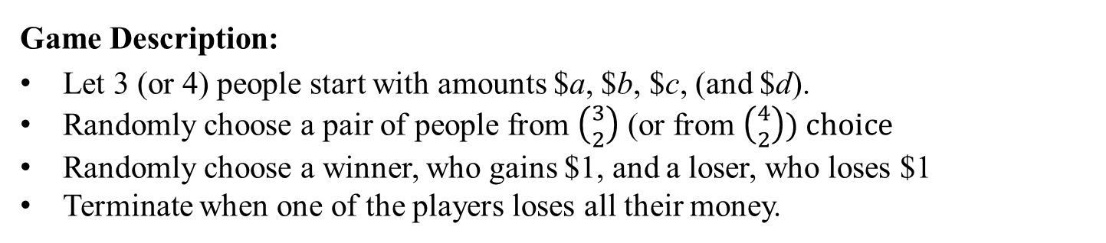
“Gambler’s Ruin” Analysis
Question: “How long does it take for the following game to end for 2, 3, or 4 people?”
Game Description:
Let 3 (or 4) people start with amounts $a, $b, $c, (and $d).
Randomly choose a pair of people from $\left({3 \atop 2}\right)$ (or from $\left({4 \atop 2}\right)) choice$
Randomly choose a winner, who gains $1, and a loser, who loses $1
Terminate when one of the players loses all their money.
Aim:
Find E[T(a, b, c)] or E[T(a, b, c, d)], where ‘T’ is the completion time

Slide 4
“Gambler’s Ruin” Analysis
We know that for m = 2, 3
where,
Number of people
Termination Time
But what if m > 3?

Slide 5
SIMULATION RESULTS
Section 1: Testing with 2 players

Slide 6

Section 1: Testing with 2 players
We perform a simulation with:
[a, b] = [$10, $10]
Thus, with E[T] = ab = 100, we performed around $2×{10}^{6}$ gambles.

Slide 7
Section 1: Testing with 2 players
Empirical PDF of Completion Time @ d=10
Beta Distribution

Slide 8
Section 1: Testing with 2 players
Running Average of Completion Time @ d=10

Slide 9
SIMULATION RESULTS
Section 2: Testing with 3 players

Slide 10

Section 2: Testing with 3 players
We perform a simulation with:
[a, b, c] = [$10, $10, $10]
Thus, with E[T] = $\frac{3abc}{a+b+c}$ = 100, we performed around $2×{10}^{6}$ gambles.

Slide 11
Section 2: Testing with 2 players
Empirical PDF of Completion Time @ d=10
Beta Distribution

Slide 12
Section 2: Testing with 2 players
Running Average of Completion Time @ d=10

Slide 13
SIMULATION RESULTS
Section 3: Testing with 4 players

Slide 14

Section 3: Testing with 4 players
We perform a simulation with:
[a, b, c, d] = [$10, $10, $10, k]
where,
Thus, with E[T] ~ 160, we performed around $3.8 ×{10}^{8}$ gambles.

Slide 15
Section 3: Testing with 4 players
Empirical PDF of Completion Time @ d=10
Beta Distribution

Slide 16
Section 3: Testing with 4 players
Empirical PDF of Completion Time @ d=20
Beta Distribution

Slide 17
Section 3: Testing with 4 players
Empirical PDF of Completion Time @ d=40
Beta Distribution

Slide 18
Section 3: Testing with 4 players
Empirical PDF of Completion Time @ d=80
Beta Distribution

Slide 19
Section 3: Testing with 4 players
Empirical PDF of Completion Time @ d=160
Beta Distribution

Slide 20
Section 3: Testing with 4 players
Running Average of Completion Time @ d=10

Slide 21
Section 3: Testing with 4 players
Running Average of Completion Time @ d=20

Slide 22
Section 3: Testing with 4 players
Running Average of Completion Time @ d=40

Slide 23
Section 3: Testing with 4 players
Running Average of Completion Time @ d=80

Slide 24
Section 3: Testing with 4 players
Running Average of Completion Time @ d=160

Slide 25
SIMULATION RESULTS
Section 4: Analysis with 4 players

Slide 26
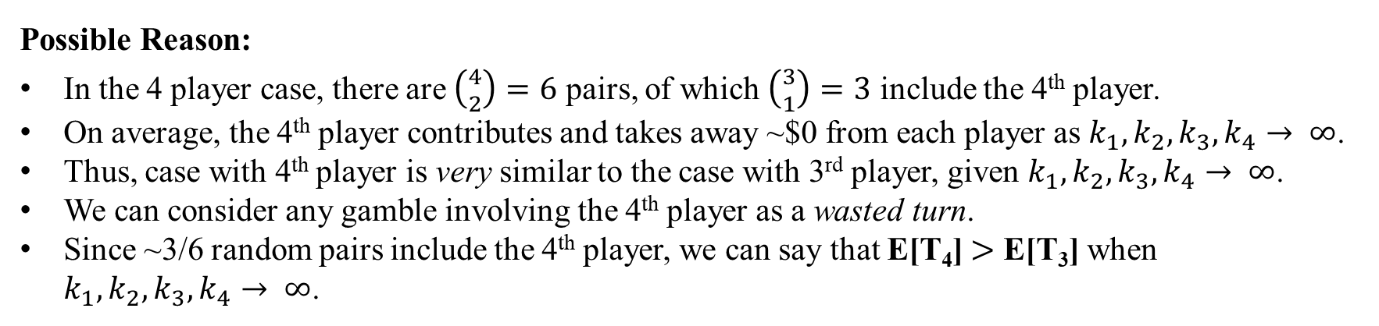
Section 4: Analysis with 4 players
Question: “Why is E[T₄] > E[T₃]?”
Possible Reason:
In the 4 player case, there are $\left({4 \atop 2}\right)=6$ pairs, of which $\left({3 \atop 1}\right)=3$ include the 4th player.
On average, the 4th player contributes and takes away ~$0 from each player as $k_{1},k_{2},k_{3},k_{4}→ ∞$.
Thus, case with 4th player is very similar to the case with 3rd player, given $k_{1},k_{2},k_{3},k_{4}→ ∞$.
We can consider any gamble involving the 4th player as a wasted turn.
Since ~3/6 random pairs include the 4th player, we can say that E[T₄] $>$ E[T₃] when $k_{1},k_{2},k_{3},k_{4}→ ∞$.

